Slide 1
Task 3: Tourism
Presentation for class discussion

Slide 2
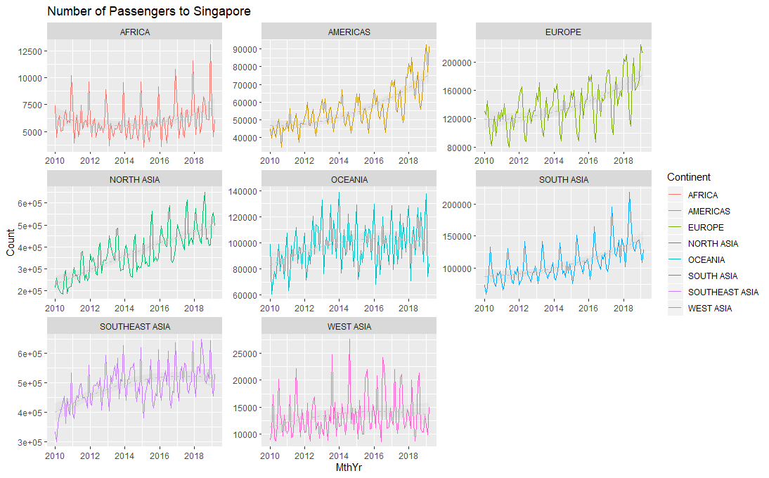
Seasonality effect is evident for most regions. There are peaks and troughs within the year.
There is an increasing trend over the years, as suggested by the quadratic regression line.
However, data is too granular to be useful.

Slide 3
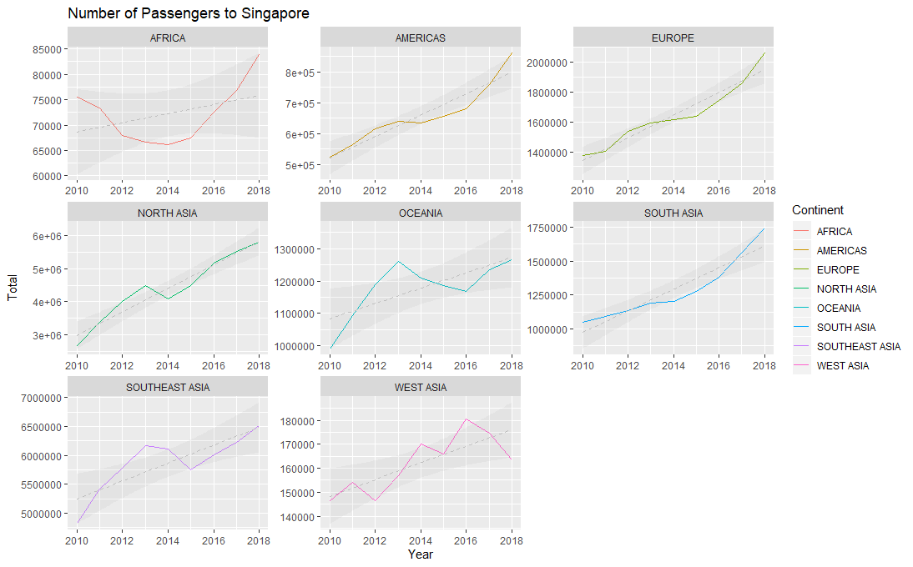
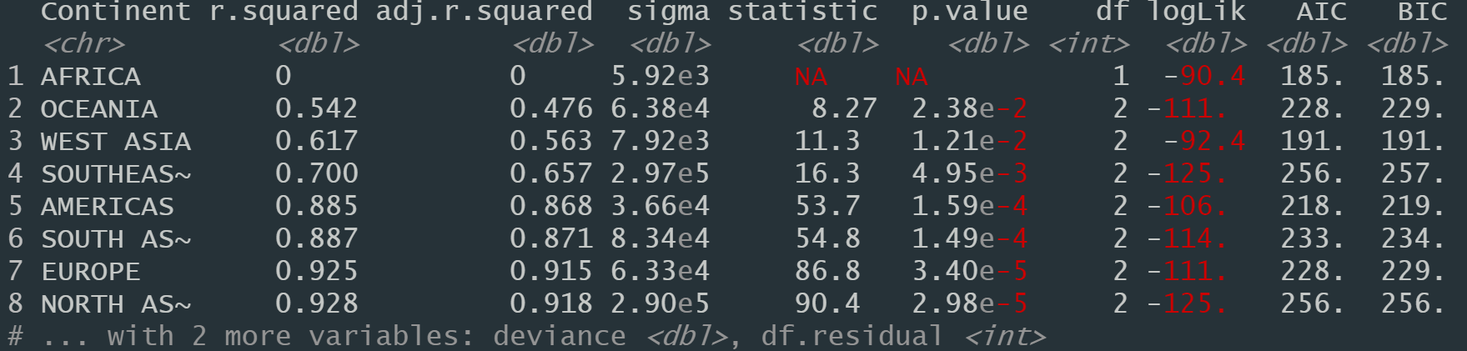
Yearly data with linear regression

Slide 4
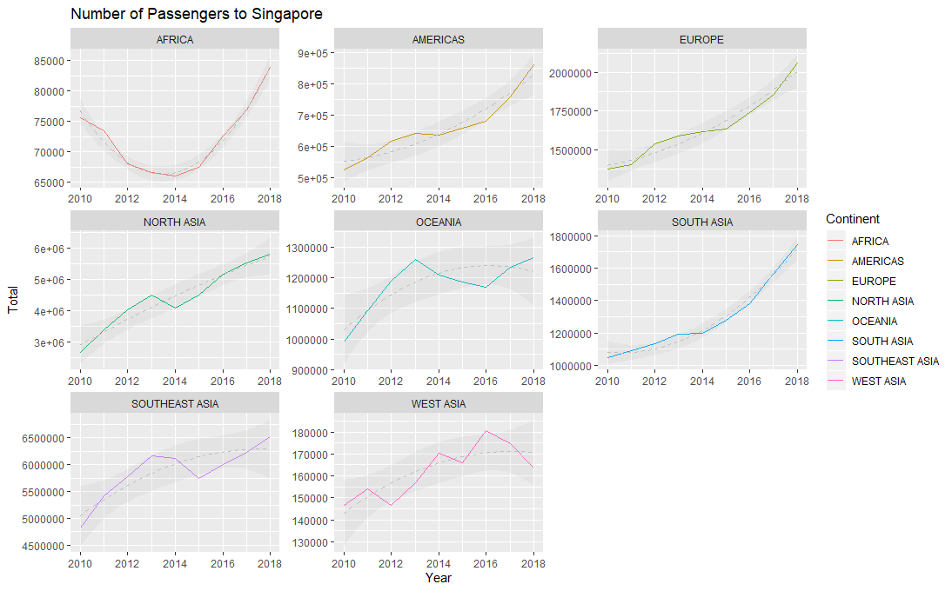
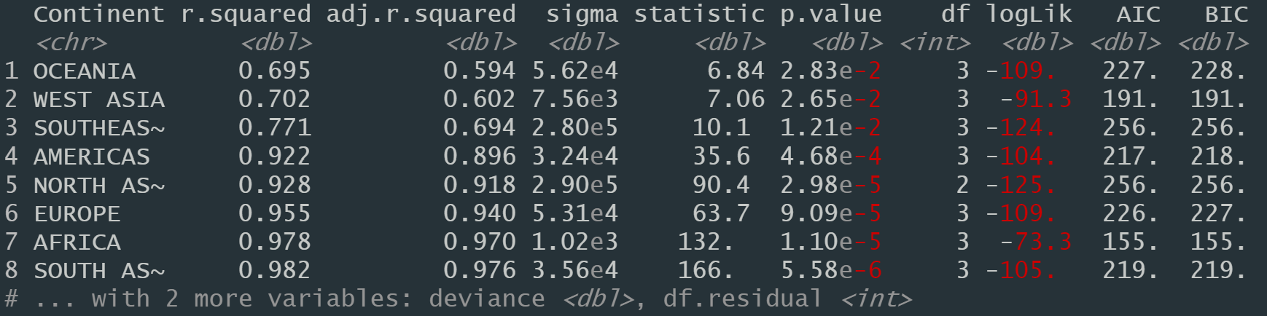
Yearly data with quadratic regression

Slide 5
Yearly data with linear regression
Improvement in adjusted R² values
But AIC values seems to increase
Quadratic regression is a better model
Yearly data with quadratic regression

Slide 6
Task 6: Sales
Presentation to business users

Slide 7
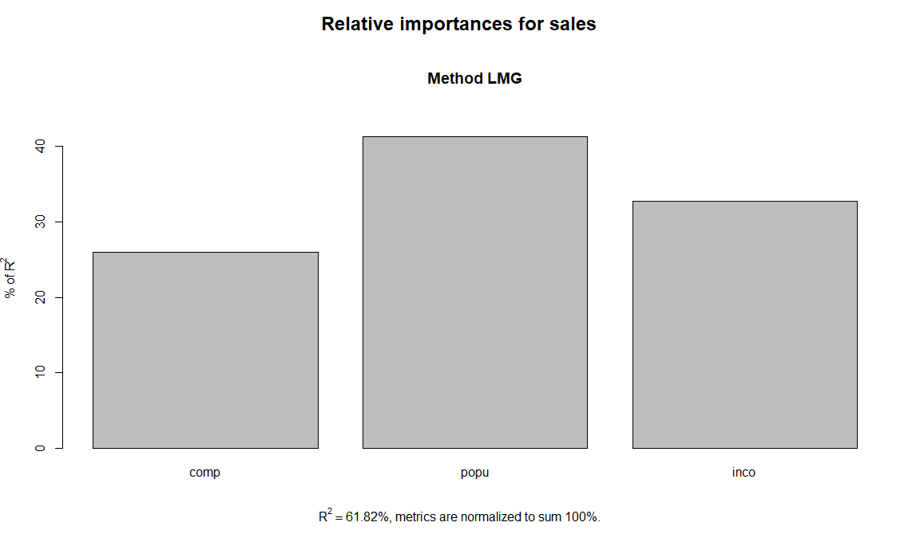
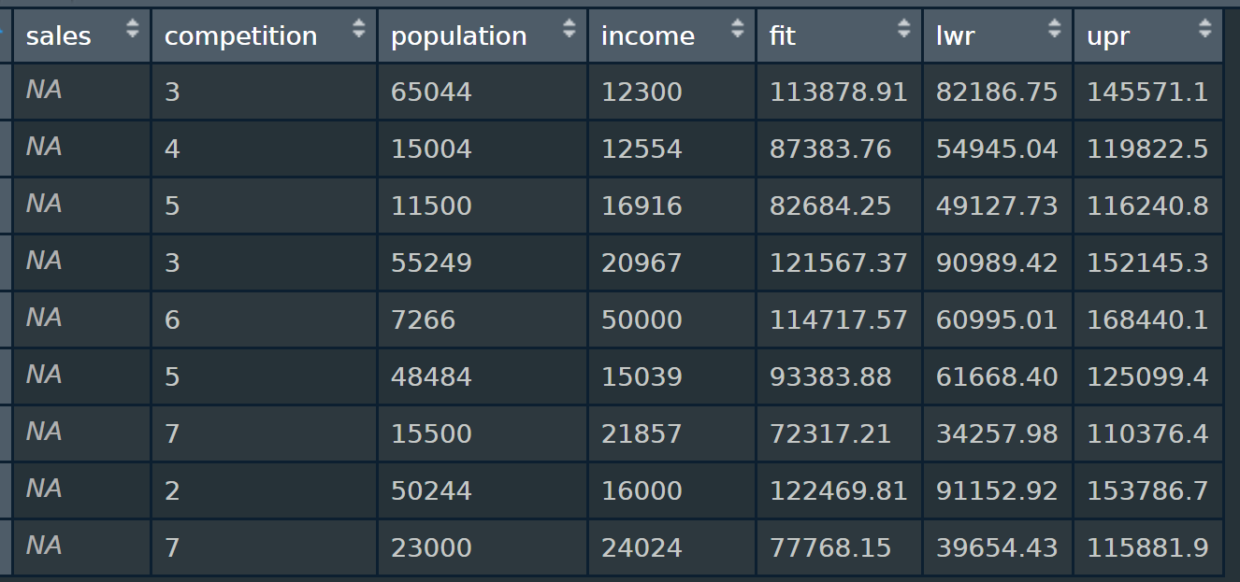
↑ Sales can be predicted by
↑ Number of people in 3 mile radius (Largest effect)
↑ Average household income
↓ Number of direct competitors in 2 mile radius (Smallest effect)
Predicted sales
Range of predicted sales
Other data useful for modelling:
Accessibility of location / Proximity to transport nodes (bus stop)
Size of store
Number of products available
FYI:
Sales (Gross Sales volume at each chain) =
-9.075e+03*competition (Number of direct competitors in 2 mile radius)
+ 3.547e-01*population (Number of people in 3 mile radius)
+ 1.288e+00*income (Average household income)
+ 1.022e+05

Slide 8
Task 7: Salary
Study

Slide 9
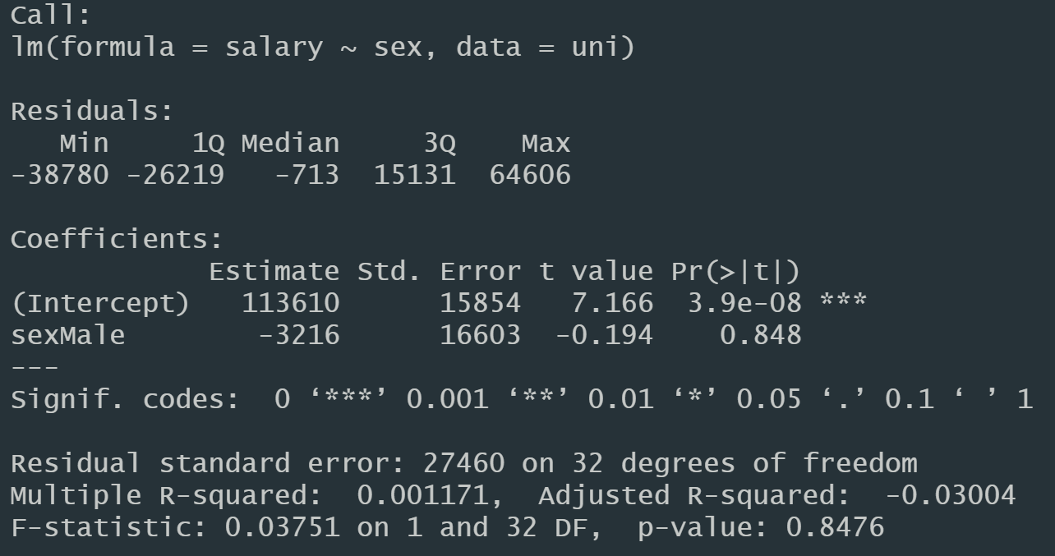
Question 1: Is there significant difference in the salaries of males and females?
#H0: μ(Male) = μ(Female): There is no significant difference in the salaries of males and females
#H1: μ(Male) =/= μ(Female): There is no significant difference in the salaries of males and females
#Finding: There is no statistically significant difference between salary and sex (Adjusted R-squared = modulus(-0.03004) < 0.7; Model p-value = 0.8476 > 0.05; sexMale = 0.848 > 0.05). Furthermore, the sample size for females is only 3 out of 34, which is too small to make any reliable conclusion.

Slide 10
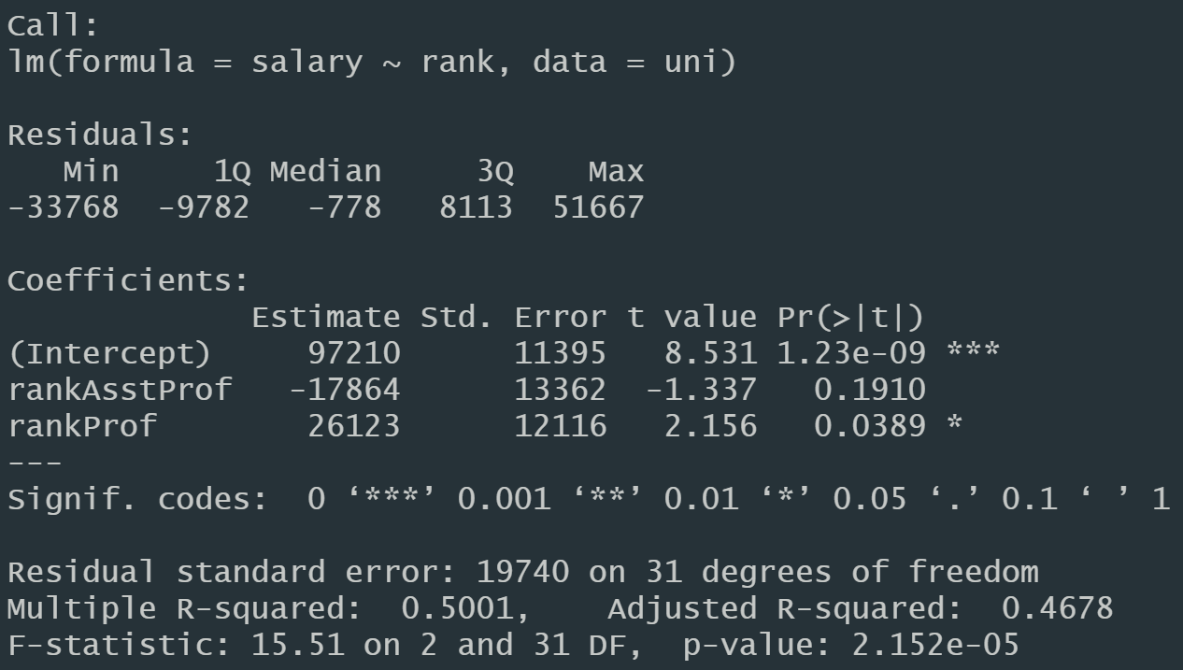
Question 2: Is there significant difference between the salaries of Assistant/Associate/Profs?
#Finding: There is statistically significant difference between salary and different types of Professorship (Adjusted R-squared = 0.4678 < 0.7; Model p-value = 2.152e-05 < 0.05; rankProf = 0.0389 < 0.05). However, the sample size for Associate Prof (3) and Assistant Prof (8) is too small to make any reliable conclusion.

Slide 11
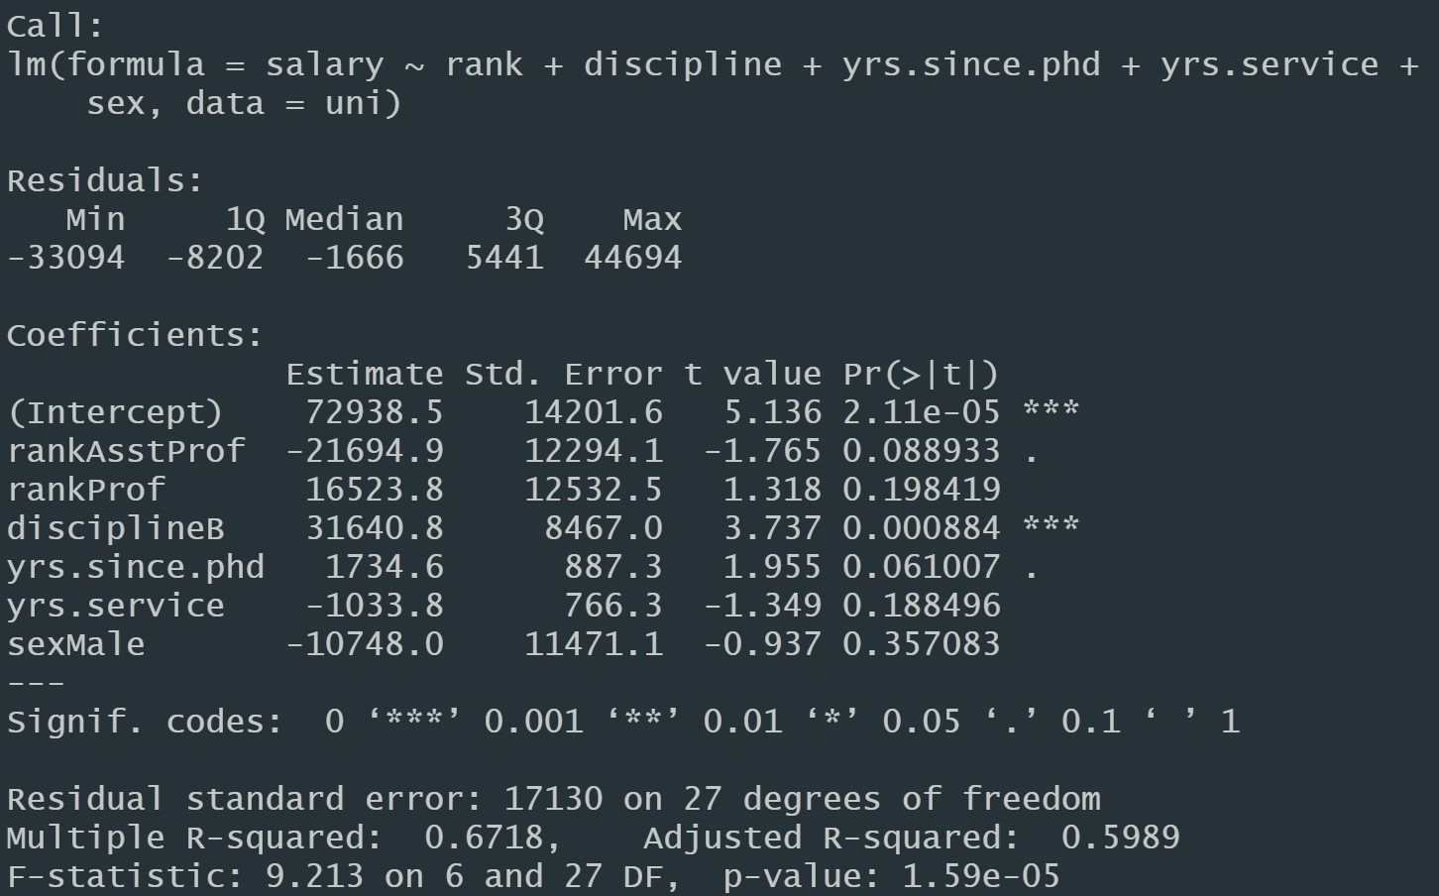
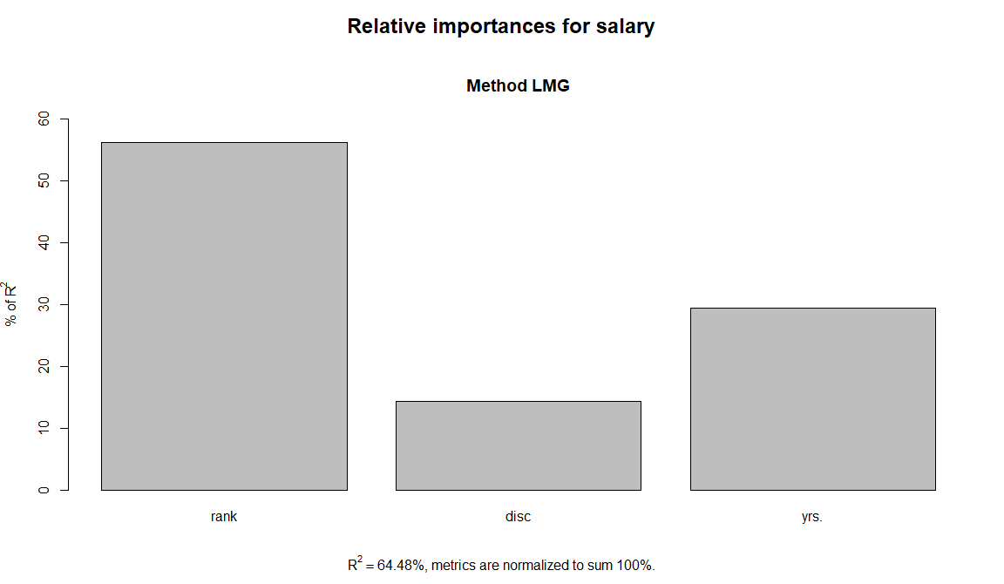
Question 3: What are the significant predictors of a faculty salary as per given data?
Significant predictors: Rank > Years > Discipline
#Finding: There is statistically significant difference between salary and various variables (Adjusted R-squared = 0.5989 < 0.7; Model p-value = 1.59e-05 < 0.05). However, the best predictors are yrs.since.phd (Years since PhD), Discipline B, rankAsstProf (Rank of Assistant Prof).

